Slide 1



Google Analytics Bootcamp
For Everyone
Instructor-Led
On-site or Remote
~7 Hours
Overview:
Digital analytics are crucial to any successful business. In this bootcamp, students will get acquainted with metrics and dimensions tracked in Google Analytics. Then, they’ll dive deeper into asking questions, gathering insights, and setting goals for their business.
Learning Objectives:
Explore the world of marketing data analytics to explain why it’s critical in today’s global market.
Get familiar with the most common metrics and dimensions within Google Analytics.
Use secondary dimensions and filters to dig deeper into each report.
Practice manipulating the reports to gain insights based on a given scenario.
Determine which of the four goal types works best for a scenario campaign.

Slide 2
Program Schedule
Day 1
10–10:30 a.m. | Welcome and Warm-Up
10:30 a.m–12 p.m. | Getting Acquainted With Google Analytics
12–1 p.m. | Asking Questions and Finding Insights
1–2 p.m. | Lunch
2–3 p.m. | Asking Questions and Finding Insights (cont.)
3–3:30 p.m. | Setting Goals
3:30–4:30 p.m. | Practice, Practice, Practice
4:30–5 p.m. | Bring It Home

Slide 3
Google Analytics Bootcamp
1.0

Slide 4
What is General Assembly?
Notes:
General Assembly was founded in NYC 2011 as a coworking hub for innovators and entrepreneurs.
When our members were asked to share their expertise with one another through impromptu classes and workshops, the potential and power of peer-to-peer mentorship emerged.
We now offer more than 25 courses online and at 20+ campuses around the world from New York, to London, to Sydney and Singapore. We also work with businesses and have trained more than 40 of the Fortune 100 companies!
We’re most proud of our 70,000 full-time, part-time, and self-led alumni, as well as the 600,000 alumni of our workshops and bootcamps — all of whom were taught by active industry professionals.
Our curricula are developed in collaboration with our global business partners to ensure they meet industry demand.

Slide 5
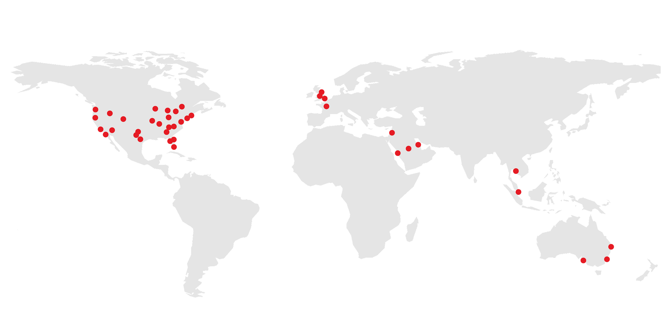
General Assembly is a pioneer in education and career transformation, specializing in today's most in-demand skills. We foster a flourishing community of professionals pursuing careers they love.
‹#› | © 2020 General Assembly
Notes:
So, who are we and why are you here? General Assembly — “GA” — is a global education institution that specializes in the most in-demand skills across data, design, technology, and business.
We offer classes, workshops, and courses in web development, design, digital marketing, data science, and business with a range of commitment options.
As part of helping individuals like yourselves acquire new skills and/or transition into a new career, we also work with a global network of employers as a source of talent. More than 9,000 of our Immersive graduates have been hired into tech careers!
TALKING POINTS:
General Assembly was founded in NYC 2011 as a coworking hub for innovators and entrepreneurs.
When our members were asked to share their expertise with one another through impromptu classes and workshops, the potential and power of peer-to-peer mentorship emerged.
We now offer courses online and at 30+ campuses around the world. We also work with businesses and have trained more than 40 of the Fortune 100 companies!
We’re most proud of our 70,000+ part- and full-time alumni, as well as the 500,000 alumni of our workshops and bootcamps — all of whom were taught by active industry professionals.
Our curricula are developed in collaboration with our expert network to emphasize real-world relevance and meet evolving employer demands.

Slide 6






What We Teach
Coding
UX & Design
Data
Marketing
Business
Career Development
‹#› | © 2020 General Assembly

Slide 7

Meet Your Instructors <Bio Slide Optional>
{Your Name}
Title, Current Positions
{Bio Info}
{Insert picture}
‹#› | © 2020 General Assembly
Notes:
Tonight we’re joined by {instructor} who teaches {course}.
You also have probably already met (mentor), who is an alumni of {course} and will be here to help you with any issues that arise during the workshop. Just flag them down. (NOT YET FULLY IMPLEMENTED)
As a final note before we get started, you will receive a follow-up email after this workshop with:
All of the slides from tonight and course information.
A screencast of this lecture. (NOT YET IMPLEMENTED)
The example we’ll work through together.
I’m going to hand things over to {instructor}, who will give you some more info about their background.

Slide 8
Icebreaker: This or That?
5 Minutes
Customize It!
Chocolate or vanilla?
Coffee or tea?
iPhone or other?
Cat or dog?
Late night or early morning?
Notes:
Purpose: Provide an opportunity for participants to get to know each other.
TEACHING TIPS:
This quick icebreaker is best for a large class.
In a physical space, draw an imaginary line down half of the classroom and have students move to the half that represents their choice or opinion.
In a remote setting, have students raise their hands on camera.
Customize it!
Swap out these options for other fun debates. Avoid politics and other sensitive topics.

Slide 9
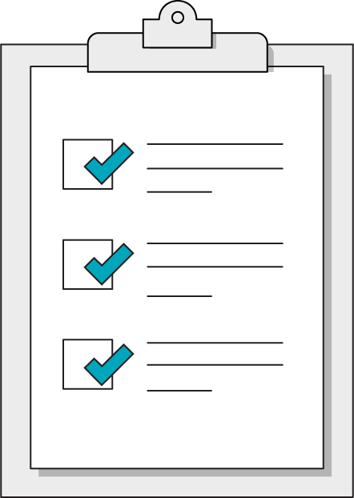
Our Learning Goals
Explore the world of marketing data analytics to explain why it’s critical in today’s global market.
Get familiar with the most common metrics and dimensions within Google Analytics.
Use secondary dimensions to dig deeper into each report.
Practice manipulating the reports to gain insights based on a given scenario.
Determine which of the four goal types works best for a scenario campaign.
Notes:
Purpose: Share the expressed goals of the lesson with students.

Slide 10
What Is Digital Analytics?
Measurement
Metrics & Dimensions
Analysis
Glean Insights
Collection
Interpretation
Make Decisions
Notes:
Purpose: Connect user experience as digital citizens to the digital analytics process.
TALKING POINTS:
We’ve seen products marketed to us on Facebook, Instagram, and other websites, and we’ve thought, “How did they know?”
Browsers collect digital data about us that marketers can then measure, analyze, and interpret. They use this information to improve their marketing, website, or app to reach their goals.
TEACHING TIPS:
Use this slide to introduce the optional note-taking resource.
Each column aligns to a stage in this cycle.

Slide 11
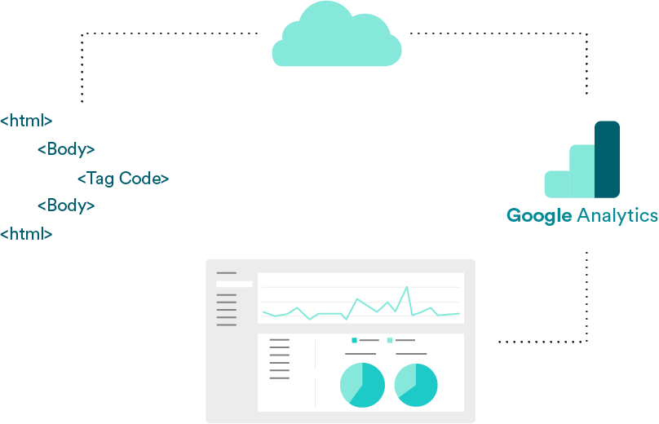
How Does Collection Work?
JavaScript code (aka a pixel) “fires” and collects information every time a user visits.
The information is then sent to the cloud.
The cloud computes and sends the raw data to Google.
Google Analytics visualizes it.
Notes:
Purpose: Explain how Google Analytics gets data into the platform.
TALKING POINTS:
When we visit a website, a cookie is sent to our computer and stored there so the browser can “remember” us for the next time we visit.
Digital analytics platforms use this technology to track our behavior on websites.
There are many tools to help you with digital analytics. Google Analytics is one of those tools.
TEACHING TIPS:
Keep this surface-level.

Slide 12
Get Acquainted With Google Analytics
Getting Acquainted With Google Analytics
Asking Questions & Finding Insights
Setting Goals
Practice, Practice, Practice
Notes:
Duration: 90 Minutes

Slide 13

What’s Coming?
Explore the world of marketing data analytics to explain why it’s critical in today’s global market.
Get familiar with the most common metrics and dimensions within Google Analytics.
Notes:
Purpose: Highlight the learning objectives we’ll tackle in this section.

Slide 14
Four Reports, Four Key Questions
1. Audience
Who’s visiting your site?
2. Acquisition
Where are they coming from?
3. Behavior
What are they doing once there?
4. Conversion
What do you want them to do when there?
Notes:
Purpose: Introduce the four reports and the key questions they answer.
TALKING POINTS:
Before we dig in, let’s get acquainted with a few basics.
The four reports:
Audience: Information about people visiting your website.
Age, gender, location, mobile or desktop, and more.
Acquisition: Information about how people got to your website.
Organic search, another website sharing the link, social media, paid ads, email campaign, and more.
Organic search involves people using a search engine (like Google) on a browser and clicking on a site (but not one listed on an ad).
Behavior: Information about what website visitors do on your website.
Pages they visit, for how long, and more.
Conversions: The actions you want people to take on your website, which indicate they’re more likely to become a customer.
Your goals.

Slide 15
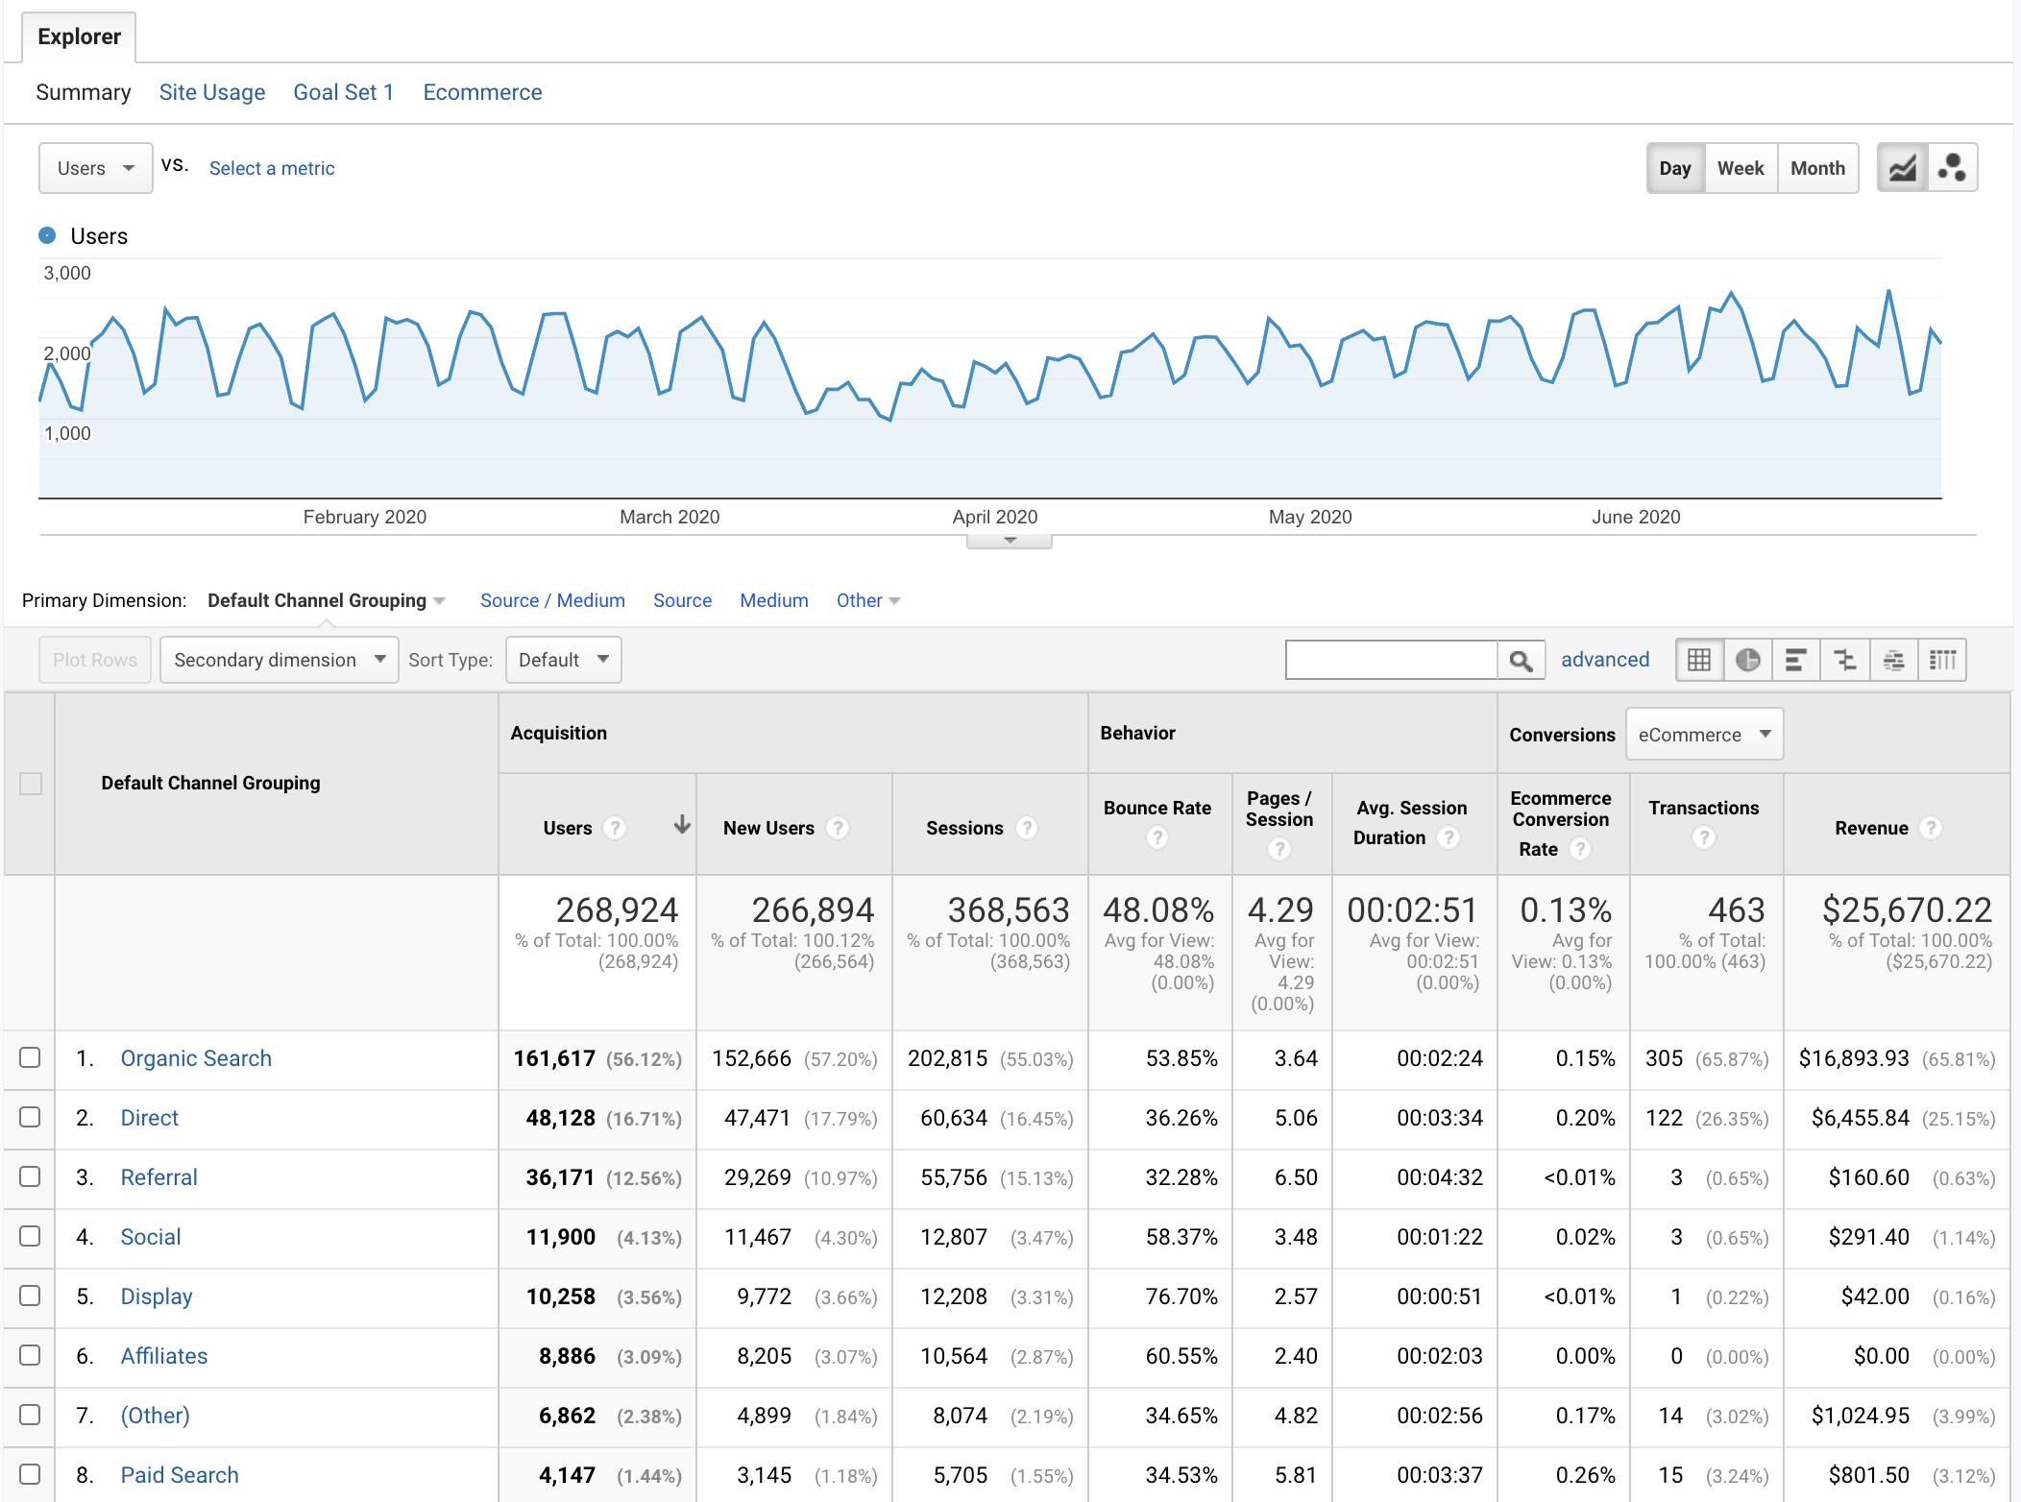
What Reports Are Made Of
Dimensions:
Attributes or Qualities That Describe the Data
Metrics:
Quantitative Data
Notes:
Purpose: Define dimensions and metrics and indicate where they can be found in the Google Analytics interface.
TALKING POINTS:
Google Analytics reports are made up of dimensions and metrics.
Dimensions are attributes or qualities that describe the data. They’re qualitative.
Metrics are quantitative data and displayed as counts, ratios, percentages, and other quantity formats. Metrics measure scale or volume (how big or how much) and efficiency (getting the expected results, not based on scale or volume).
When manipulating reports, ask yourself:
Which dimensions would be useful for me to know about my customers?
Which metrics would be useful to know about my customers?
TEACHING TIPS:
This is just an introduction. By the time students get hands-on with reports (during later modules), they’ll get a feel for using dimensions to segment data and metrics.
Additional resource for students: Google’s Dimensions and Metrics Explorer

Slide 16


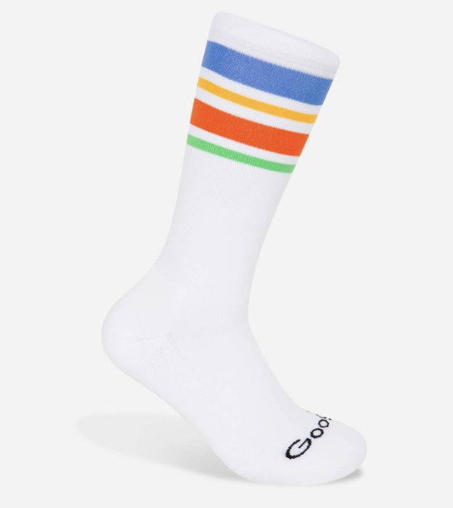
Did You Know Google Makes Socks?
Yup, Google has a merchandise store.
We’ll be looking at the Google Analytics of the Google merchandise site to answer questions like:
Who visits?
Where do they come from?
What do they do on the site?
What do they buy?
Notes:
Purpose: Introduce the scenario we’ll use throughout the class.
TALKING POINTS:
Throughout the class, we’ll pretend to be marketing analysts at Google tasked with exploring the data collected in Google Analytics for the Google Merchandise Store.

Slide 17
Accessing the Google Demo Account
Go to https://analytics.google.com/analytics/web/demoAccount.
You’ll either be prompted to log in to your Google account or create an account if you don’t have one.
Click the “ACCESS DEMO ACCOUNT” link.
Google Support: Demo Account
Notes:
Purpose: Provide directions for accessing the Google Analytics demo account.
TALKING POINTS:
We’ll be using Google’s demo account data today so you can practice manipulating actual data within the platform.
By accessing the demo account, you agree to let Google add it to your Analytics account or create one associated with your Google account, then add it to your new Analytics account.
TEACHING TIPS:
Over the next few slides, we will not be in the Google Analytics interface, so be sure to set that expectation with students.
For remote classrooms:
Share the directions and link on this slide with students via Slack.

Slide 18
Introducing Google Analytics
During your demos, please add a standard date range (at least three months) and tell students to do the same.
This will ensure that students see the same data you’re showing.
For example, use the dates January 1–June 30, 2020 and tell students to do the same.

Slide 19
Guided Walk-Through
Activity + Debrief Guide
Prompt students to follow along on their own computers.
In this 10-minute walk-through, you need to cover:
How to access each report.
The big picture of what students can learn.
Common dimensions.
Common metrics (skip conversion metrics).
After sharing the goals on the next slide, you can stop sharing the deck and navigate to Google Analytics. Return to the deck after covering the above points in the audience report. The next slide you should share is the activity.
The slides between this and the activity are mainly for students to reference post-course when they receive this deck as a PDF file. Edit as needed following the “Customize it!” directions.

Slide 20
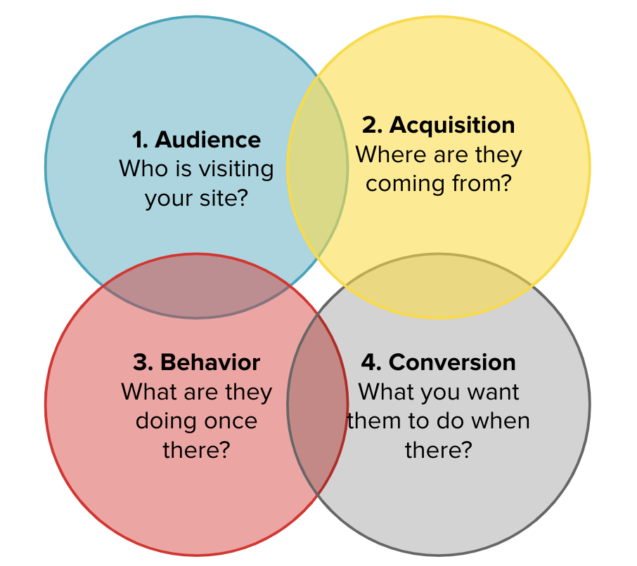
Initial Walk-Through
Goals:
Access each report.
Specify what we can learn from each.
Learn common dimensions.
Learn common metrics.
Notes:
Purpose: Share the goals for the initial walk-through.
TALKING POINTS:
We’ll revisit the platform many times throughout the day and dive a little deeper each time.
The overview tab of each report provides the big picture we can drill into using the dimensions.
TEACHING TIPS:
Encourage students to take notes on their note organizer.

Slide 21
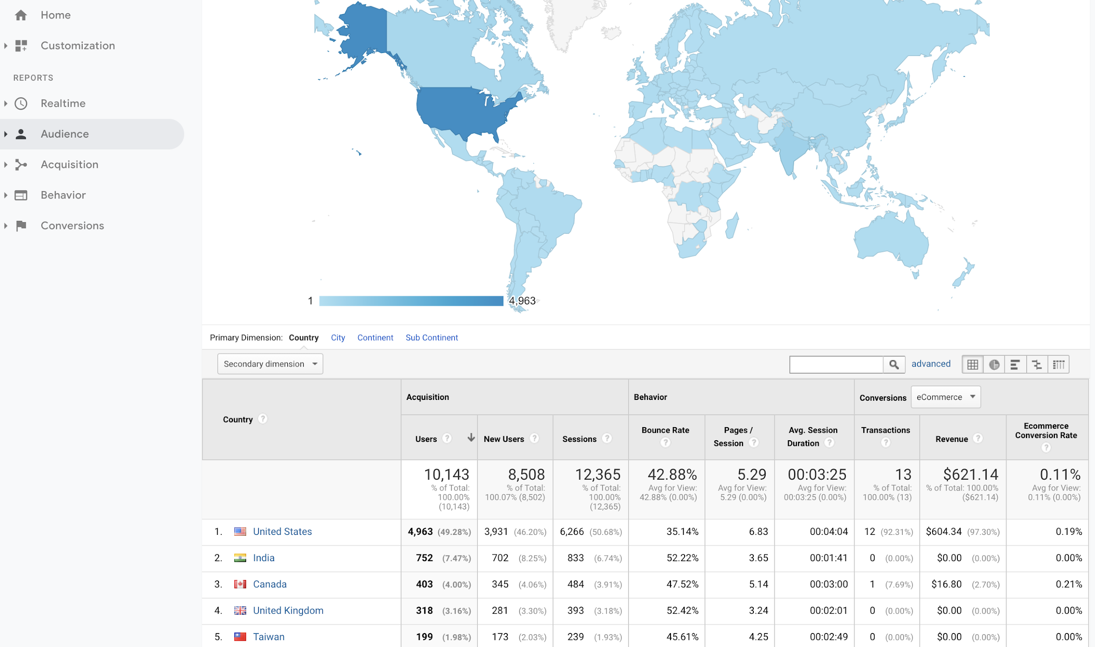
Where to Find the Four Reports
Notes:
Purpose: A reference for students to use post-course.

Slide 22
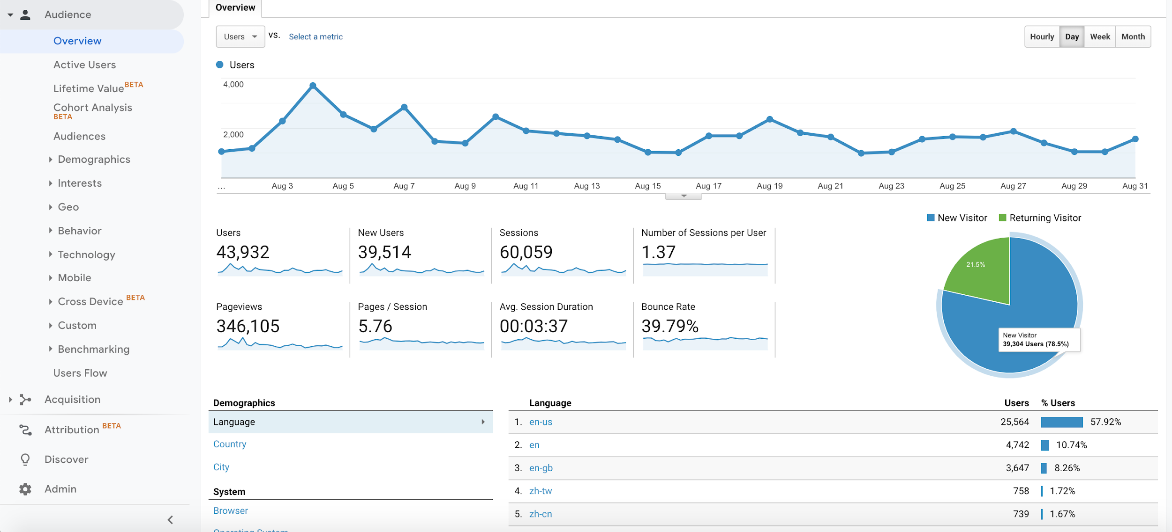
Audience Overview: Our Users
Audience → Overview
Notes:
Purpose: A reference for students to use post-course.

Slide 23
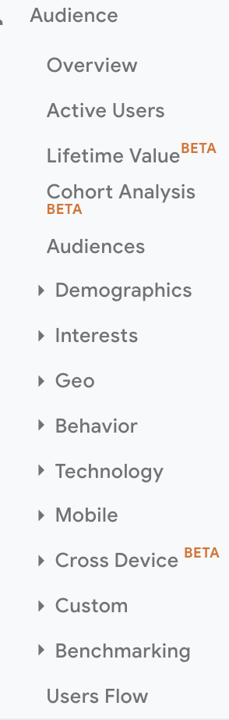
Common Audience Dimensions
Customize It!
Age, gender
Language, location
Browser and operating system
Device (e.g., iPhone, iPad, Pixel 4, and others)
Workbook pg. 2
Notes:
Purpose: A reference for students to use post-course.
Customize it!
Adjust if you plan to cover other dimensions. We recommend you cover these at the least.

Slide 24
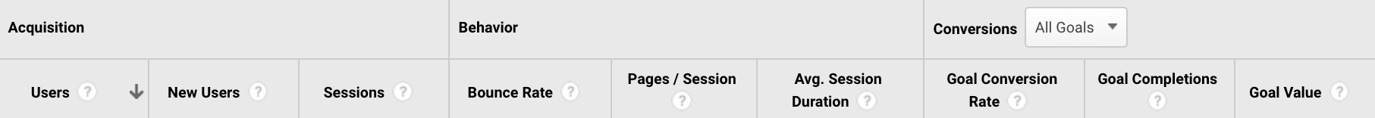
Audience Metrics
Customize It!
People who visit the site within a date range.
The time a user is active on a website within a date range.
Average pages a user views per session.
First-time users within a date range.
Percentage of time people arrive at the website and leave immediately.
Average amount of time a user spends on your website.
Notes:
Purpose: A reference for students to use post-course.
TALKING POINTS:
The more you click into the dimensions, other metrics become available (beyond what is seen here). For the purpose of today, we’ll focus on these.
Customize it!
Adjust if you plan to cover other metrics. We recommend saving “Conversions” for later.

Slide 25
Who Are They?
5 Minutes
Customize It!
Take five minutes to learn something about our users.
Be prepared to share your insight.
“Our users are …”
“Our users use …”
Notes:
Purpose: Give students an opportunity to use the audience report to better understand users.
TALKING POINTS:
The audience report helps us understand our users a bit more.
TEACHING TIPS:
After five minutes, have students share what they learned.
Lead a discussion on how they might use that info.
For remote classrooms:
Encourage students to come off mute and share their insights.
Customize it!
Use different starter questions (if preferred).

Slide 26
Acquisition Guided Walk-Through
Activity + Debrief Guide
Prompt students to follow along on their own computers.
In this 10-minute walk-through, you need to cover:
How to access the report.
The big picture of what students can learn.
Common dimensions (focus on “Channels” and “Source/Medium” under “All Traffic”).
Common metrics.
You can stop sharing the deck and navigate back to Google Analytics. The next slide you should share is the activity.
The slides between this and the activity are mainly for students to reference post-course when they receive this deck as a PDF file. Edit as needed following the “Customize it!” directions.

Slide 27
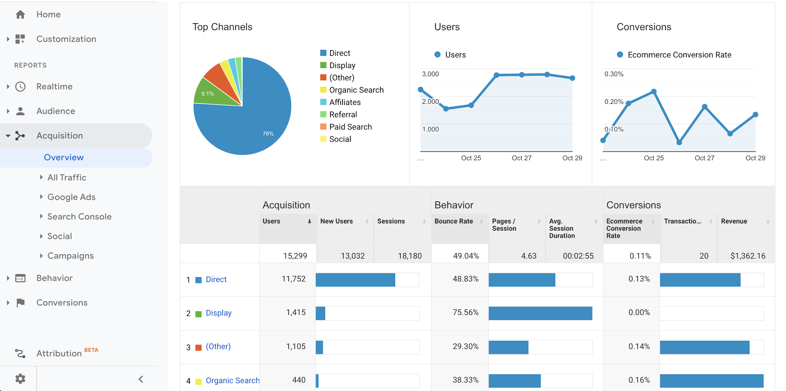
Acquisition Overview: How Users Get to Our Site
Acquisition → Overview
Notes:
Purpose: A reference for students to use post-course.

Slide 28
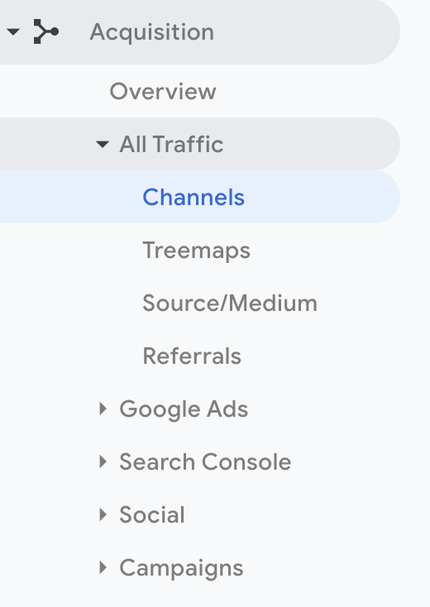
Acquisition Dimensions
Customize It!
Broad channels users come from (e.g., social, organic search, and others)
The specific website users came from
Notes:
Purpose: A reference for students to use post-course.
Customize it!
Adjust if you plan to cover other dimensions. We recommend you keep it focused on “Channels” and “Source/Medium” under “All Traffic.”

Slide 29
Acquisition Metrics
Customize It!
People who visit the site within a date range.
The time a user is active on a website within a date range.
Average pages a user views per session.
First-time users within a date range.
Percentage of time people arrive at the website and leave immediately.
Average amount of time a user spends on your website.
Notes:
Purpose: A reference for students to use post-course.
The more you click into the dimensions, other metrics become available beyond what is here. For today, we’ll focus on these.
Users are counted only once within 24 hours.
Customize it!
Adjust if you plan to cover other dimensions. We recommend saving “Conversions” for later.

Slide 30
How Do They Get Here?
5 Minutes
Which channel do most users come from? Least?
Customize It!
Take five minutes to learn something from the acquisition report.
Then, we’ll share out.
Users from which source have the longest average session duration?
Users from which channel have the highest bounce rate?
Which sources are most effective at bringing in new users?
Notes:
Purpose: Give students an opportunity to gain insights from the acquisition report.
TEACHING TIPS:
The speech bubbles serve as inspiration — students do not have to answer them.
After five minutes, have students share what they learned.
For remote classrooms:
Encourage students to come off mute and share their insights.
Customize it!
Use different starter questions if you prefer.

Slide 31
Behavior Guided Walk-Through
Activity + Debrief Guide
Prompt students to follow along on their own computers.
In this 10-minute walk-through, you need to cover:
How to access the report.
The big picture of what students can learn from each.
Common dimensions (skip “Behavior Flow” for this initial introduction).
Common metrics.
You can stop sharing the deck and navigate back to Google Analytics. The next slide you should share is the activity.
The slides between this and the activity are mainly for students to reference post-course when they receive this deck as a PDF file. Edit as needed following the “Customize it!” directions.

Slide 32
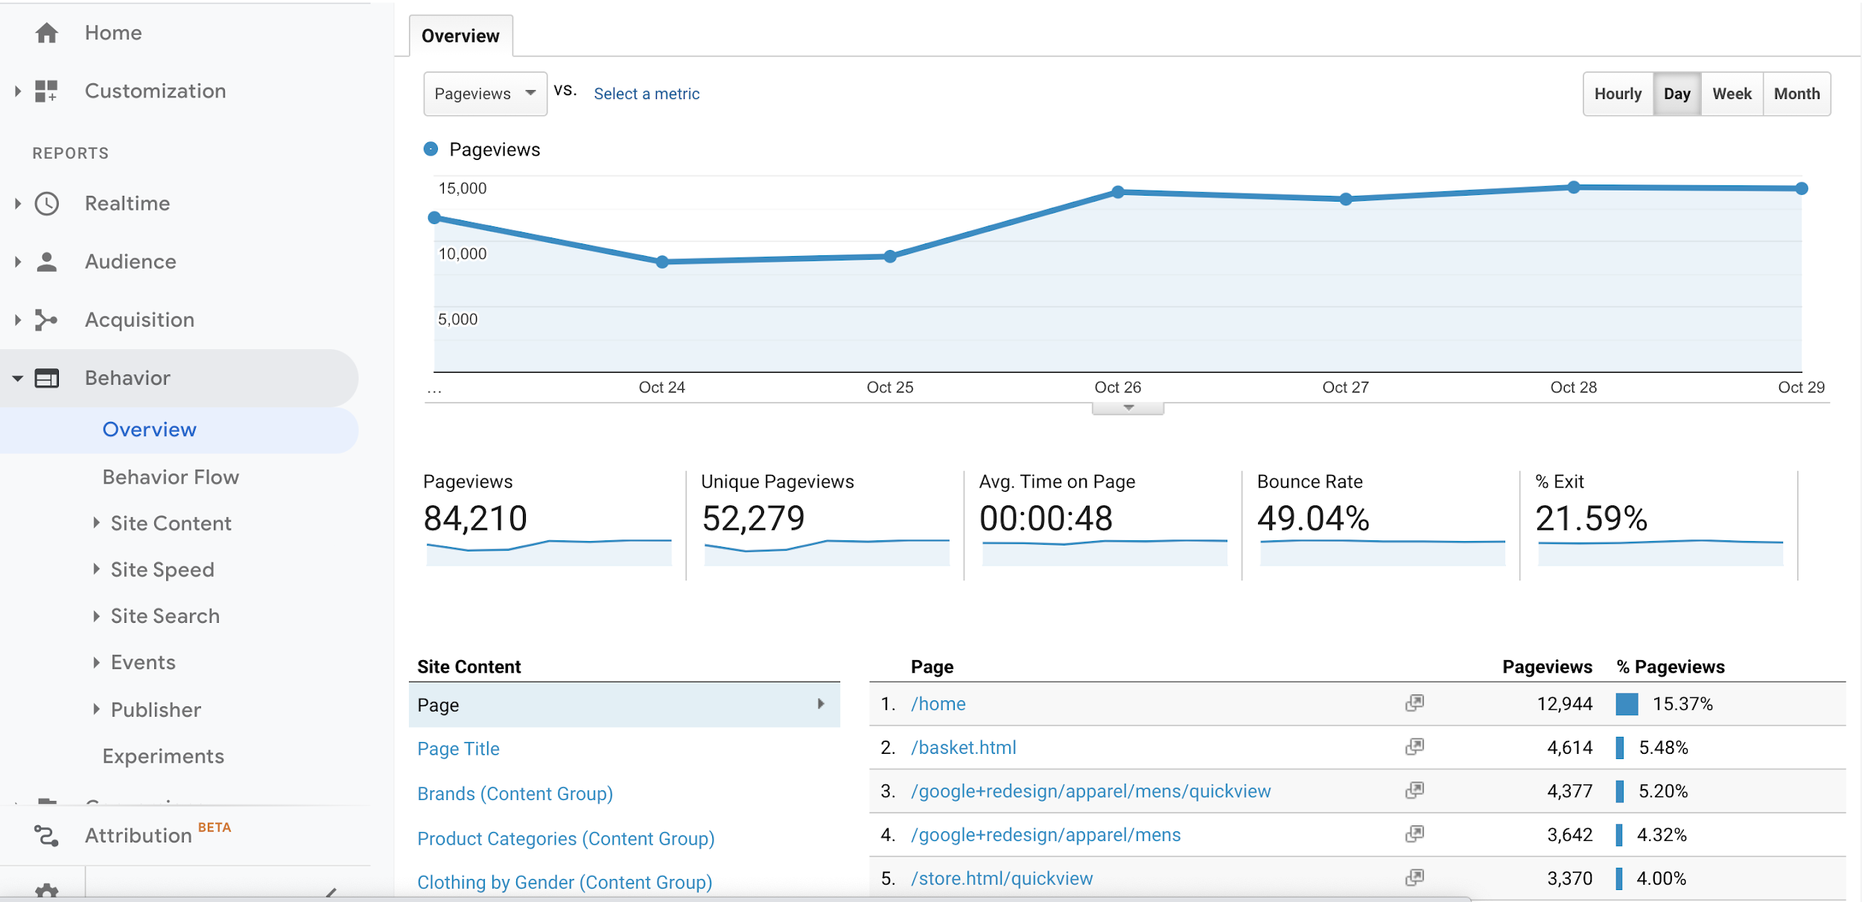
Behavior Overview: What Users Do on Our Site
Behavior → Overview
Notes:
Purpose: A reference for students to use post-course.

Slide 33
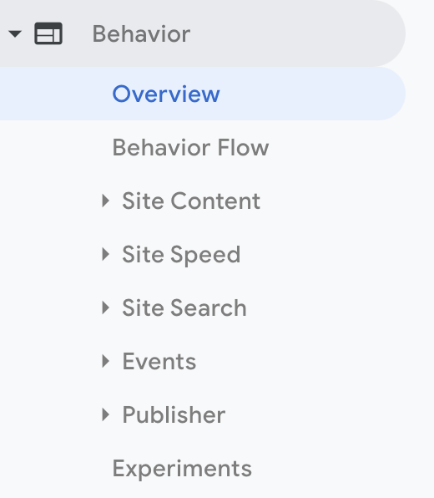
Common Behavior Dimensions
Customize It!
Shows which pages users are visiting.
Shows what people are doing (e.g., what they are clicking on).
Notes:
Purpose: A reference for students to use post-course.
TALKING POINTS:
Events are special metrics within the behavior report.
They help measure how users navigate the site, which can provide insight to improve the user experience.
You need to add code to the website to track them.
Customize it!
Adjust if you plan to cover other dimensions. We recommend skipping “Behavior Flow” for this initial walk-through.

Slide 34
Behavior Metrics
Customize It!
Page visited.
The number of sessions during which pages were viewed at least once.
The number of times users entered the website through a specific page.
The number of exits divided by the number of pageviews for a specific page.
Total number of pages viewed.
The percentage of single-page sessions with no interactions with the page.
The average amount of time users spent viewing a specific page.
Notes:
Purpose: A reference for students to use post-course.
TALKING POINTS:
Unique Pageviews: On each row in a report, this is the number of sessions during which a specific page is viewed. The total is the number of unique pageviews of all pages added together.
Customize it!
Adjust if you plan to cover other metrics. We recommend skipping “Page Value.”

Slide 35
What Are Users Doing?
5 Minutes
Which page do most users enter through?
Customize It!
Take five minutes to learn something from the behavior report.
Then, we’ll share out.
Compare the bounce rate of two pages.
Which page has the lowest average time on page?
Notes:
Purpose: Give students an opportunity to glean something from the behavior data.
TEACHING TIPS:
The speech bubbles serve as inspiration — students do not have to answer them.
After five minutes, have students share what they learned.
For remote classrooms:
Encourage students to come off mute and share their insights.
Customize it!
Use different starter questions if you prefer.

Slide 36
Trivia
Bragging Rights
The fourth and final report is called ...
Notes:
Purpose: Introduce the transition from acquisition to conversion in a fun way.
TALKING POINTS:
Who knows the answer?
TEACHING TIPS:
Determine and communicate how you’d like students to share their answers:
Slack thread.
Volunteer.
Come off mute or shout out.
Other ways.

Slide 37
Conversion Guided Walk-Through
Activity + Debrief Guide
Prompt students to follow along on their own computers.
In this 10-minute walk-through, you need to cover:
How to access each report.
The big picture of what students can learn from each.
Common dimensions (“Goal URLs” and “Reverse Goal Path” are the most important).
Common metrics.
You can stop sharing the deck and navigate back to Google Analytics. The next slide you should share is the activity.
The slides between this and the activity are mainly for students to reference post-course when they receive this deck as a PDF file. Edit as needed following the “Customize it!” directions.

Slide 38
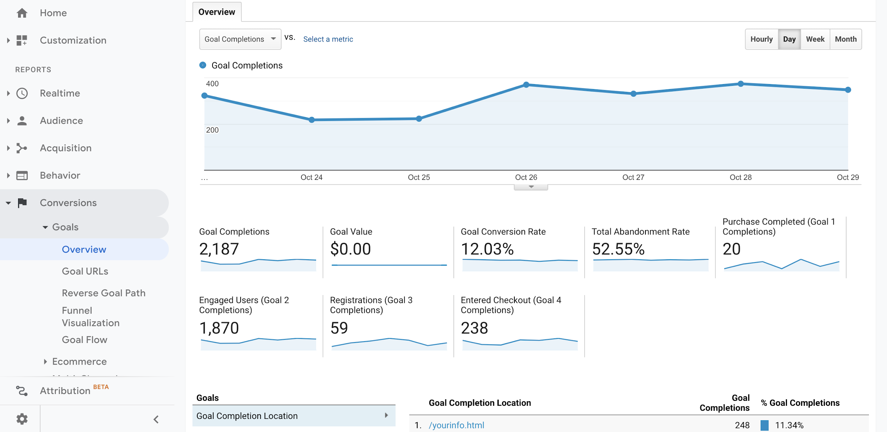
Conversion Goals Overview: Overall Results
Conversions → Goals → Overview
Notes:
Purpose: A reference for students to use post-course.

Slide 39
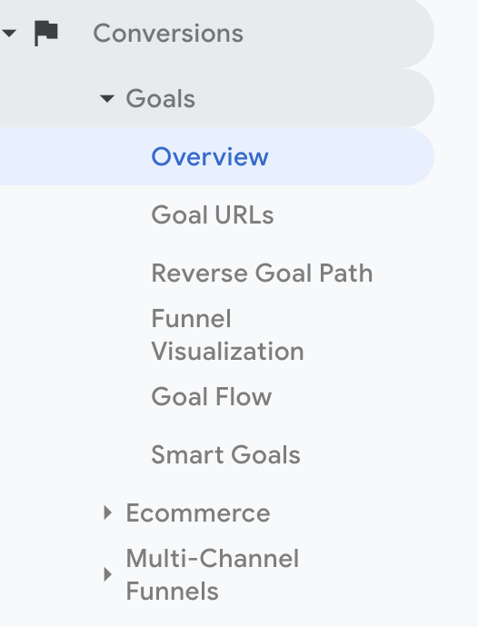
Conversion Goals Dimensions
Goal completion location (URLs).
How the user got to the goal URLs.
Notes:
Purpose: A reference for students to use post-course.
Customize it!
Adjust if you plan to cover other dimensions.

Slide 40
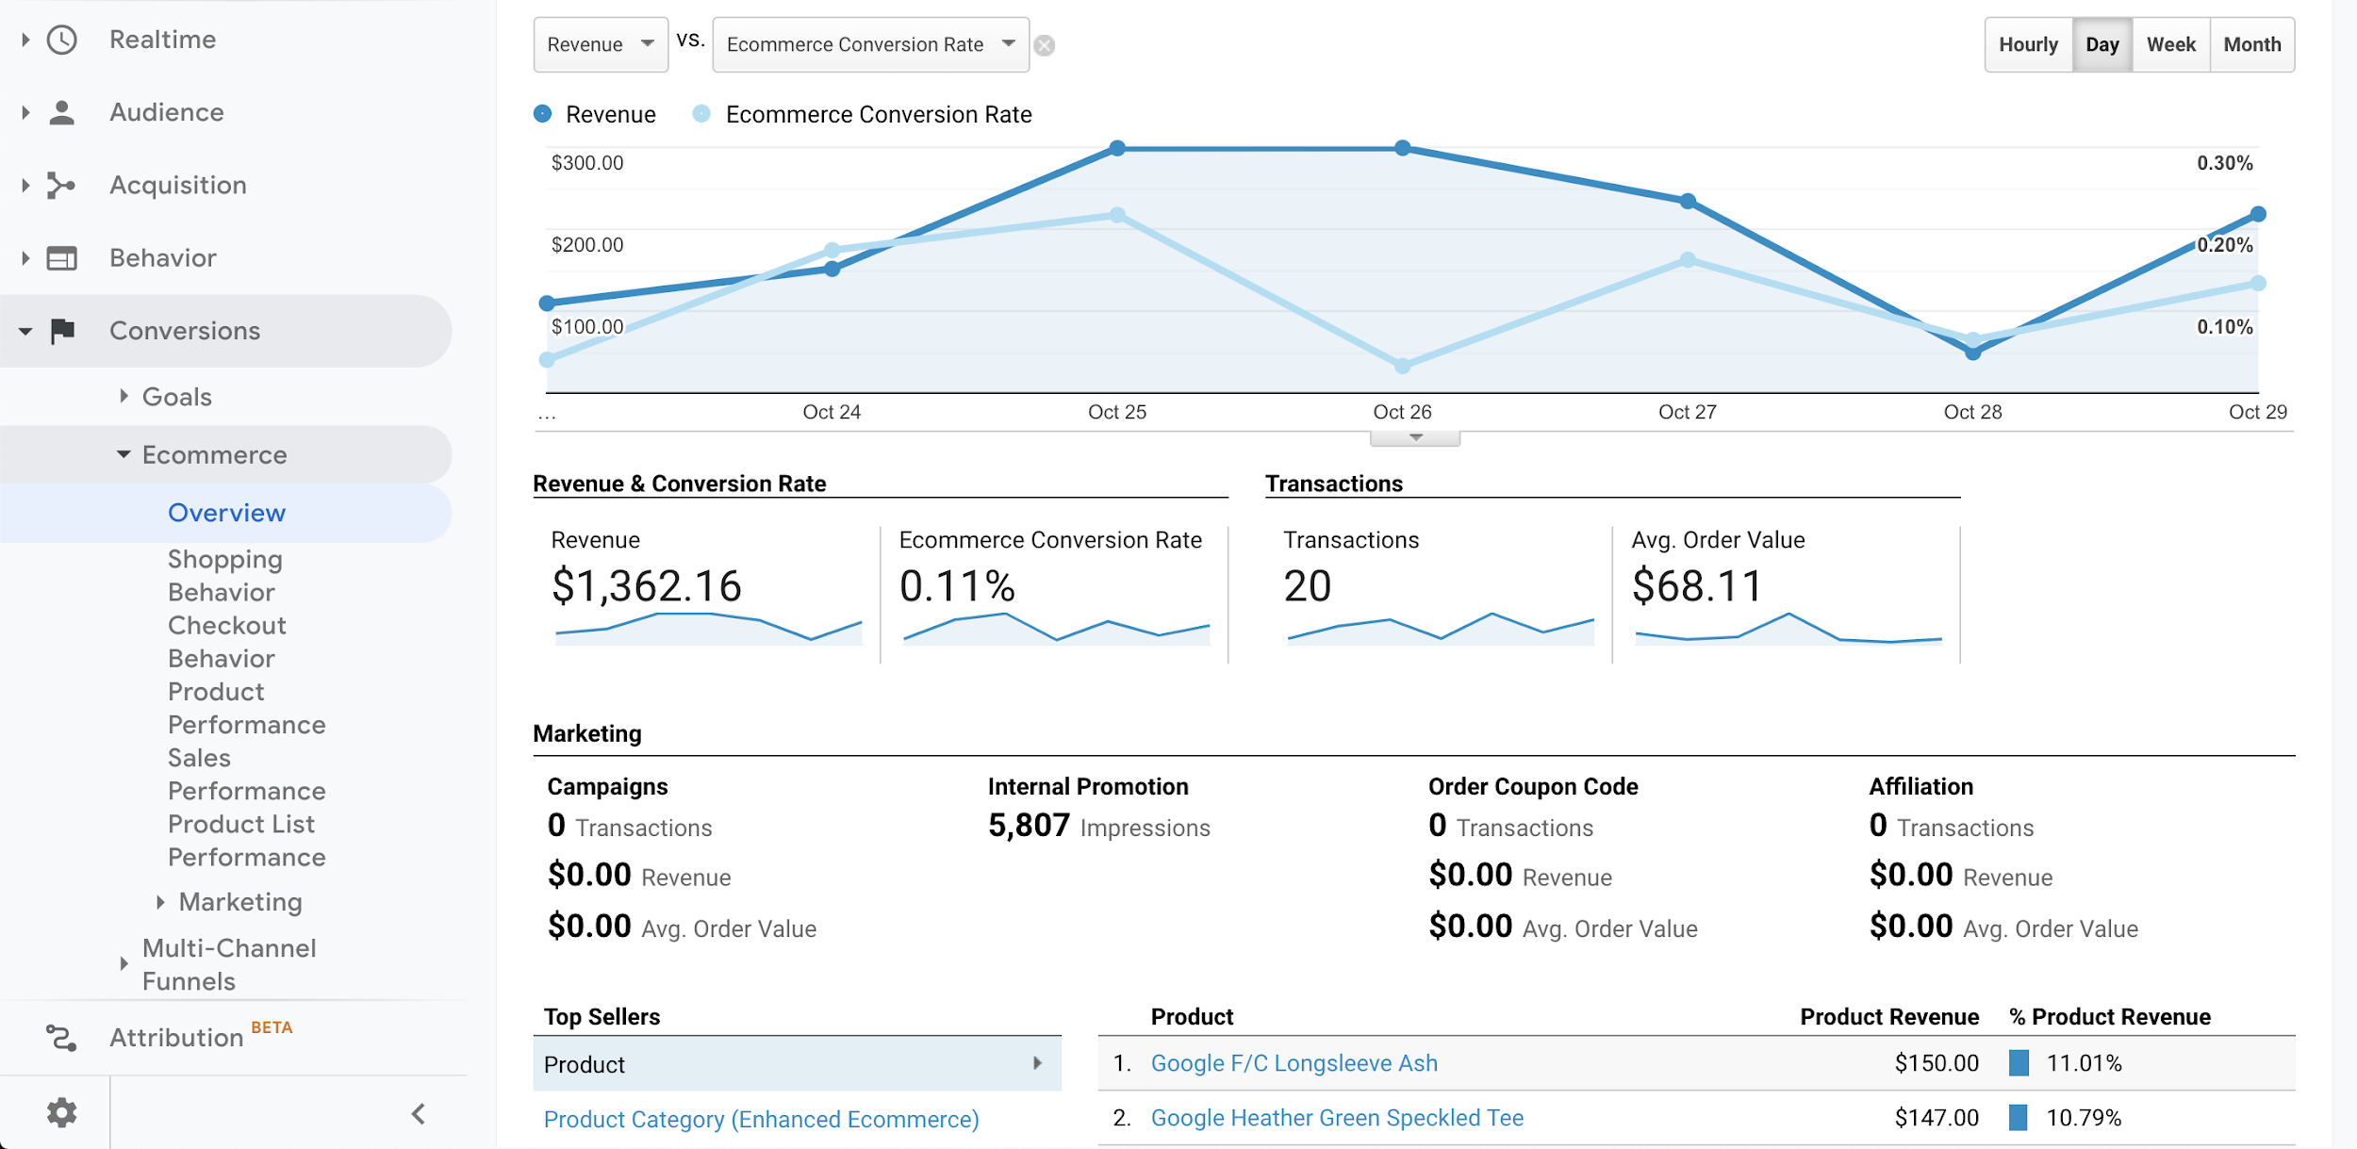
Conversion eCommerce Overview: What We’re Selling
Notes:
Purpose: A reference for students to use post-course.

Slide 41
Partner Exercise
Activity + Debrief Guide
Activity
Give students 10 minutes to answer as many questions as they can.
Be sure to provide a 7-day and 90-day range for students and enter that on the activity slide so their answers are the same as yours.
Debrief
Spend five minutes on this debrief. We suggest debriefing by asking groups to share the answer they got and inquiring whether any group has a different answer.
Confirm the correct answer. There are only three questions so this should be doable in five minutes.

Slide 42
More Practice
10 Minutes
Customize It!
With a partner, use the home page view to find answers to the following questions using the date ranges below.
7-day range:
90-day range:
What are the top three pages in terms of pageviews?
Which day has the most number of sessions?
Which channel has been the most productive for bringing new users to your site in the designated time frames?
Notes:
Purpose: Give students an opportunity to practice navigating the platform and start thinking about questions they can ask.
TALKING POINTS:
Let’s do a bit more practice.
For remote classrooms:
Take a screenshot of this slide and post it on Slack.
Create breakout rooms for partners.
When the breakout rooms expire and everyone returns to the main room, lead a debrief by encouraging students to come off mute and share their answers.
Customize it!
Add a 7-day and 90-day range for students to use.

Slide 43
Asking Questions & Finding Insights
Getting Acquainted With Google Analytics
Asking Questions & Finding Insights
Setting Goals
Practice, Practice, Practice
Notes:
Duration: 120 Minutes (Breakdown: 60 minutes before lunch, 60 minutes after lunch.)

Slide 44
What’s Coming?
Use secondary dimensions and filters to dig deeper into each report.
Practice manipulating the reports to gain insights based on a given scenario.
Notes:
Purpose: Highlight the learning objectives we’ll tackle in this section.

Slide 45

How Did We Get Here?
We’re now more comfortable with what data is collected by the platform.
Our next step is to learn how to combine different dimensions and metrics for analysis to find out why we care.
For example, we know Google Analytics collects data on which devices our users use, but why does that matter to our business?
Let’s find out.
Notes:
Purpose: Set the context for this section.
TALKING POINTS:
We covered the “what.” It’s time to take it to the next level and ask questions of the data to get insights into what is and isn’t working about our campaigns.
Over the next two hours, you’ll practice manipulating the sub-reports within audience, acquisition, behaviors, and conversion.

Slide 46
Secondary Dimensions
Up until now, we’ve only looked at data segmented by a single characteristic — a primary dimension.
For example, we can find out how many users came to our site by way of organic search.
Secondary dimensions allow us to dig deeper into the data.
For example, how many users that came to our site by way of an organic search are 25–34 years old?
Notes:
Purpose: Introduce secondary dimensions.
TALKING POINTS:
We can learn a lot from Google Analytics, but so far, we’ve only been running at half speed.
Secondary dimensions allow us to drill down and get even more specific with what we’re learning.
Think of it as “stacking” characteristics to gain access to more specific insights.

Slide 47
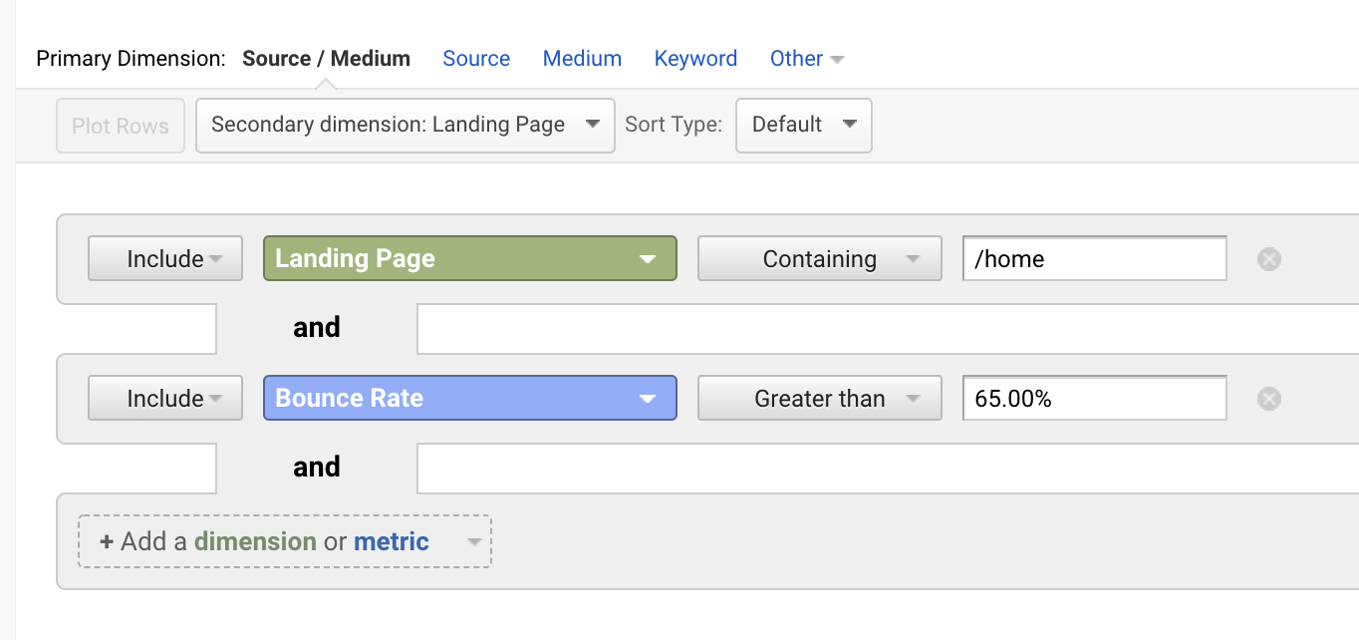
More Drilling With Filters
Filters help get rid of the “noise” so you can focus on specifics.
You can select which dimensions or metrics to include or exclude.
Notes:
Purpose: Introduce filters.
TALKING POINTS:
Filters allow you to exclude or include information based on dimensions or metrics.
You can use multiple filters. (See “+Add a dimension or metric” below the second filter.)
Notice that you can filter to include or exclude information using search parameters like “Containing,” “Exactly matching,” “Begins with,” and “Ends with.”
What’s the difference between secondary dimensions and filters?
Secondary dimensions make your questions more specific.
Filters make the results more relevant to your question.
TEACHING TIPS:
Lightly touch on where to find search and filters. (Search is the box on the upper right with the magnifying glass and filters are created by clicking on “Advanced” next to the search box.)
Note that you’ll provide more detail in at least one of the walk-throughs that follow.

Slide 48

Audience: Who Are My Best Users?
Looking at our audience through different dimensions and metrics can help us learn more about how certain users are performing compared to others.
Which segment of users spent the most?
Which segment of users bounced less?
Which segment of users are frequent users?
Notes:
Purpose: Introduce the kinds of questions we can ask of the audience report.
TALKING POINTS:
Within the audience report, we can learn characteristics about our users.
Is a particular audience performing better or worse when compared with others?
If your site engages a particular audience, should you devote more marketing spend to target those users?
If your site is not engaging a specific audience, should you reassess if trying to convert that audience is worth spending on?
If your target audience is engaging with your site but leaving quickly, should you audit the pages and content to identify what’s preventing their conversion?
Segmenting users based on characteristics will help you build the personas of your target customers.
TEACHING TIPS:
Encourage students to take notes on their note organizer.

Slide 49
Audience Walk-Through
Activity + Debrief Guide
You have 10 minutes to demonstrate how to ask and answer specific questions about the audience via a scenario and:
Using secondary dimensions and filters.
Connecting an insight to planning a campaign.
A scenario is provided, but you may customize it if you’d like.
You can stop sharing the deck and navigate back to Google Analytics. The next slide you should share is the solo exercise.

Slide 50
Asking Audience Questions
10 Minutes
Customize It!
We want to double-down on our marketing tactics to increase users from the age group that’s most active on our site.
Let’s use the audience report to:
Identify which age group is most active.
Learn something about this age group that might help us in planning our campaign.
Practice using secondary dimensions and filters.
Notes:
Purpose: Use a scenario to walk through how to ask powerful questions of the reports.
TEACHING TIPS:
Set the same date range.
Find the age group with the most sessions (how we’re defining most active in this scenario).
Dig in further to uncover insight about this age group.
What device is most common among this age group?
What language do they speak?
What city do they live in?
Be sure to connect this insight to how we would use it to plan a campaign (e.g., tweak ad messaging to target iPhone users or decide where to set location-based marketing on social media ads).
Customize it!
Change the campaign details to target a different dimension (age) and metric (sessions).

Slide 51
Your Turn
10 Minutes
Set the date range to the last three months.
Use the audience report to learn something about your users that will help you plan a campaign.
You can use the guiding questions below or come up with your own.
What age or gender has the most users? Least number of users?
What age or gender had the lowest bounce rates? Highest bounce rates?
What location had the highest number of sessions?
Which device is most popular for each?
What landing pages worked best on mobile vs. not mobile?
Be prepared to share what you discover.
Notes:
Purpose: Give students the opportunity to practice how to ask questions when digging into the reports.
TEACHING TIPS:
You can turn this into a partner activity, depending on the class.
Be sure to save a few minutes for students to share their insights.
Challenge them to think about how they might use the insight they uncover to inform their campaign.
Takeaway: We can use this information to determine marketing messaging or targeting (overhaul if we want to attract different people or tweak if we want more of the same audience).

Slide 52


Acquisition: Which Avenues Are Most Productive?
Using the acquisition report, we can answer questions like:
What sources were most effective in driving users to our site?
Which channels bring the most users within a target age range?
The answers to these questions can help us decide where we want to spend our marketing budget.
Notes:
Purpose: Explain the importance and use of the acquisition report.
TALKING POINTS:
The acquisition report is a critical report to review when assessing your marketing budget.

Slide 53
Acquisition Walk-Through
Activity + Debrief Guide
You have 10 minutes to demonstrate how to ask and answer specific questions about where the audience comes from via a scenario and:
Using secondary dimensions and filters
Connecting an insight to planning a campaign.
A scenario is provided, but you may customize it if you’d like.
You can stop sharing the deck and navigate back to Google Analytics. The next slide you should share is the partner exercise.

Slide 54
Asking Acquisition Questions
10 Minutes
Customize It!
You want to spend some extra marketing budget to boost traffic from your most successful channel.
Let’s use the acquisition report to:
Identify which channel sends the most users to your site.
Learn which age group enters your site most from that channel.
Practice using secondary dimensions and filters.
Notes:
Purpose: Use a scenario to walk through how to ask powerful questions of the reports.
TEACHING TIPS:
Set the same date range.
Find the channel that sends the most users.
Add age as a secondary dimension to identify which age group comes to your site most from that channel.
Be sure to connect this insight to using to spend our extra budget most responsibly.
Customize it!
Change the scenario to uncover a different insight.

Slide 55
Asking the Right Questions: Acquisition
10 Minutes
Set the date range to the last three months.
Use the acquisition report to learn something about your users that will help you plan a campaign.
You can use the guiding questions below or come up with your own.
Which source sent the most users?
Which source had the highest goal 1 conversion rate?
Which medium had the highest number of transactions?
Which source had the lowest bounce rate?
Be prepared to share what you discover.
Notes:
Purpose: Practice navigating the platform with a partner and coming up with questions to dig into.
TEACHING TIPS:
You can turn this into a solo activity if you’d like.
Be sure to save a few minutes for students to share their insights.
Challenge them to think about how they might use the insight they uncover to inform their campaign.
Takeaway: Spending money or energy on channels that are successfully getting users to your site.
Encourage students to take notes on their note organizer.
For remote classrooms:
Take a screenshot of this slide and post it on Slack.
Create breakout rooms for partners.
When the breakout rooms expire and everyone returns to the main room, lead a debrief by encouraging students to come off mute and share their answers.

Slide 56

Time for Lunch!

Slide 57
This is both a science and an art.
Customize It!
Notes:
Purpose: Highlight that the process of finding insights on Google Analytics is not formulaic and requires you to think outside the box.
TALKING POINTS:
It would help if you were a bit of a detective when digging into the platform. There’s so much data stored and a lot of ways to arrive at the answer.
The best way to experiment is by digging into the reports themselves to learn how to get the best data for your questions.
It’s a little bit of science and a little bit of art.
Customize it!
Move this slide around anywhere in the next section. This message is best delivered when students have had some experience in the platform.

Slide 58
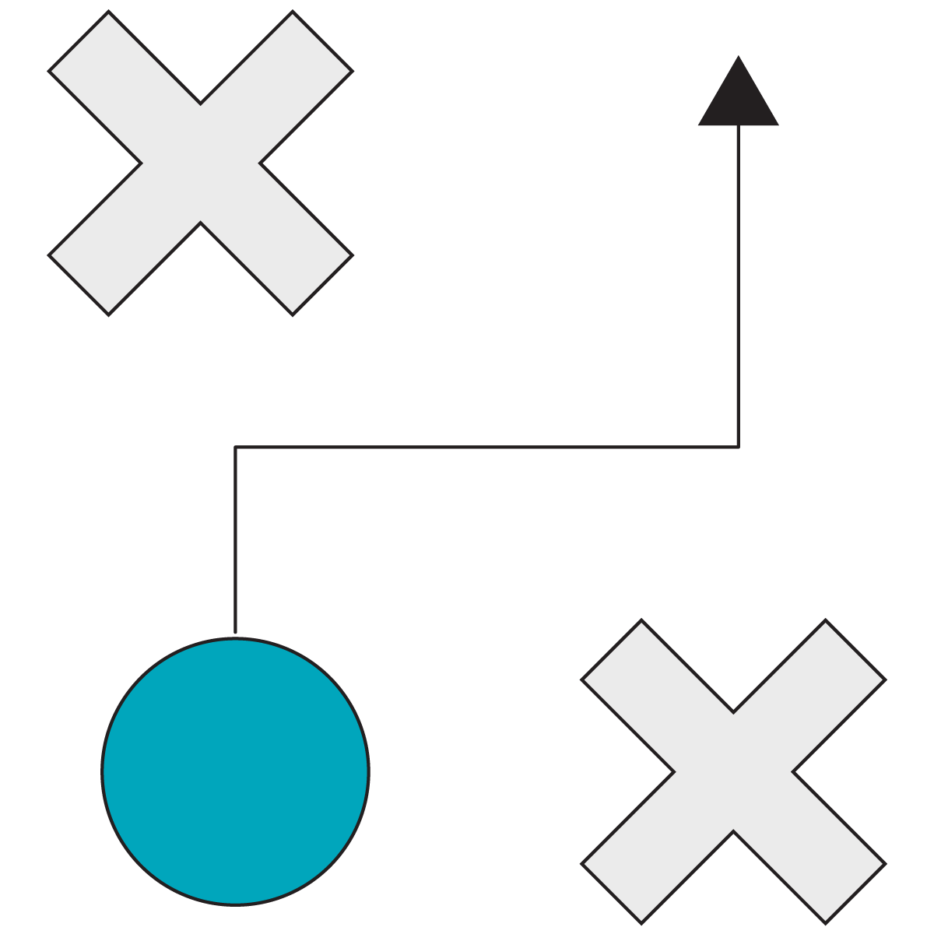
Behavior: How Are Users Engaging With Our Site?
The behavior report can help us find answers to questions like:
Which page has the most pageviews?
Which landing pages have the best conversion rates?
Which pages do users leave from most often (exit pages)?
Which call-to-action buttons are working on various pages?
Notes:
Purpose: Introduce what questions we can ask of the behavior report.
TALKING POINTS:
The behavior report helps us understand how users are engaging with the site, what content resonates with them and what does not, and more.

Slide 59
Behavior Walk-Through
Activity + Debrief Guide
You have 10 minutes to demonstrate how to ask and answer specific questions about what the audience does on the site via a scenario and:
Using secondary dimensions and filters.
Connecting an insight to planning a campaign.
A scenario is provided, but you may customize it if you’d like.
You can stop sharing the deck and navigate back to Google Analytics. The next slide you should share is the solo exercise.

Slide 60
Learning About User Behavior
10 Minutes
Customize It!
You’ve been given design and engineering resources to redesign one page on your website.
Let’s use the behavior report to:
Identify which of the pages with the 10 highest pageviews has the lowest bounce rate.
Identify which has the highest average time on page.
Practice using secondary dimensions and filters.
Notes:
Purpose: Use a scenario to walk through how to ask powerful questions of the reports.
TEACHING TIPS:
Set the same date range.
Go to Site Content > All Pages > Sort Pageviews.
Find the lowest bounce rate.
Find the highest average time on page.
Connect how we might use this info in our redesign.
What content is resonating with users, which pages are more successful than others, and more?
Encourage students to take notes on their note organizer.
Customize it!
Change the scenario to uncover a different insight.
You can also touch on the following:
All Pages: Toggle to see “Page Title” to identify the most popular pages.
Content Drilldown: Click on the page to figure out what’s so popular within this section.
Landing Pages: Figure out which pages perform the best and see if you can identify why to replicate it elsewhere.
Exit Pages: This report helps you quickly identify pages that need redesigning. It’s helpful to analyze these pages and see if you can bring anything over your most successful pages.

Slide 61
Your Turn
10 Minutes
Set the date range to the last three months.
Use the behavior report to plan your page redesign.
You can use the guiding questions below or come up with your own.
Which page has the most page views? Page title?
Click into /google+redesign. What part of the website is the most popular?
What landing pages are resonating with users?
What are the top exit pages for users?
Why is there such a high exit percentage from the home page?
Be prepared to share what you discover.
Notes:
Purpose: Give students the opportunity to practice how to ask questions while digging into the reports.
TEACHING TIPS:
You can turn this into a partner activity, depending on the class.
Be sure to save a few minutes for students to share their insights.
Challenge them to think about how they might use the insight they uncover to inform the redesign.

Slide 62
Conversion Walk-Through
Activity + Debrief Guide
You have 10 minutes to demonstrate how to ask and answer specific questions about conversions.
A scenario is provided, but you may customize it if you’d like.
You can stop sharing the deck and navigate back to Google Analytics. The next slide you should share is the next section divider on “Setting Goals.”

Slide 63
Conversion Report
10 Minutes
Customize It!
Your marketing team needs to focus their efforts on two or three channels. Use Google Analytics to identify which channels would result in the most conversions.
Let’s jump into the conversion report to answer questions like:
Which channels work best with each other to achieve conversions?
Which channels don’t work together?
Which pair has the highest percentage of working with direct?
Notes:
Purpose: Use a scenario to walk through how to ask powerful questions of the reports.
TEACHING TIPS:
Set the dates of the model to a six-month period.
Use the Venn diagram in Conversion Report > Multi-Channel Funnels > Overview tab to answer the questions.
You’ll need to explain what it means when two channels intersect in the diagram. Use an example of a person: “Dino arrived at our page via x channel and again via y channel and converted.”

Slide 64
Setting Goals
Getting Acquainted With Google Analytics
Asking Questions & Finding Insights
Setting Goals
Practice, Practice, Practice
Notes:
Duration: 30 Minutes

Slide 65
What’s Coming
Determine which of the four goal types is most relevant for your business.
Notes:
Purpose: Highlight the learning objectives we’ll tackle in this section.

Slide 66

What’s Next?
We’ve spent a lot of time exploring the four reports in Google Analytics.
We’ve learned the common metrics and dimensions and how we can ask questions to gather insights from the data.
In this section, we’ll learn about setting goals so we can use data to suggest action.
Notes:
Purpose: Set up what we’ll do in this section.

Slide 67

Establish Your Baseline
Observe the data to determine what is typical:
Daily?
Weekly?
Monthly?
Yearly?
Notes:
Purpose: Introduce establishing a baseline.
TALKING POINTS:
To set goals, we need to know what is typical.
Baselines give us a starting point we can measure against.
For example, if we were to set a goal to run our fastest mile yet, we’d need first to understand what our current mile time is.
Start tracking your baseline as soon as possible. Don’t wait until you’re ready to launch a campaign.
To figure out what is normal and typical, ask these questions:
What happens every day?
What happens every week?
What happens every month?
What happens every year?

Slide 68



With a Baseline, You Can Identify:
Bad Exceptions
Learn what isn’t working.
Do less of it.
Example: This landing page has a 15% higher bounce rate than our baseline.
Good Exceptions
Learn what is working.
Do more of it.
Example: The summer campaign Facebook ad converts 3% more than any other campaign.
Notes:
Purpose: Introduce good and bad exceptions.
TALKING POINTS:
Why do you want to figure out what’s different? To know what your actions should be.
If it’s a good exception, find out what made it happen and do more of it.
If it’s a bad exception, find out what made it happen and do less of it.
Exceptions are how you improve what you’re doing; it’s how you become a learning organization.

Slide 69
What Are Goals & Goal Completions/Conversions?
Goal
An action you want people to take on your site that makes them more likely to become a customer.
Conversion
When a website visitor takes the action you set as a goal.
vs.
Notes:
Purpose: Emphasize the difference between goals and goal completions/conversions.
TALKING POINTS:
Getting people to your website may be easy, but if they aren’t the right people, it doesn’t matter.
The right people are those who want what you’re selling and are willing to buy it.
The rest is about making sure you get the highest number of conversions for the least amount of money.
Conversions are the same thing as goal completions.
Setting goals and tracking goal completions/conversions are two separate actions.
What matters most is conversions — this will help you identify what’s working to do more of it.

Slide 70
Types of Goals We Can Track
Destination | Events | Pages/Screens per Session | Duration
When users fill out a form and are sent to a confirmation page, that page is the destination | Set a specific action to be a goal. Everytime a user performs that action, it counts as a conversion. | Did a user visit the specified number of pages and/or screens? | Set a goal time that users spend on your site.
Example: Users submit their email addresses to subscribe to our newsletter. | Example: Clicking play on our video. | Example: Seven unique pages within one session. | Example: How long did users spend on your website in total?
Most common
Notes:
Purpose: Define the goal types in Google Analytics.
TALKING POINTS:
Destination and events are the most common goal types.
Pages/Screens per session are most relevant to “think tanks,” blogs, and media outlets.
For the duration, you can set the parameter to be “greater than” or “less than.” But duration spent on each page is tracked in behavior, so it’s not common to set a goal for this.
A destination goal can also be an event goal.
TEACHING TIPS:
Focus on destination and events.

Slide 71
Goal Setting Walk-Through
Activity + Debrief Guide
You have 10 minutes to demonstrate how to set a goal.
Briefly walk through how to set up each goal on the platform while talking through best practices:
Naming best practices.
How to determine duration and pageview goals.
And more.
Students will not be able to follow along in the demo site. It may be helpful to pull up your personal or professional account to show them what this would look like.
The step-by-step walk-through slides are mainly for students to reference post-course when they receive this deck as a PDF file.

Slide 72
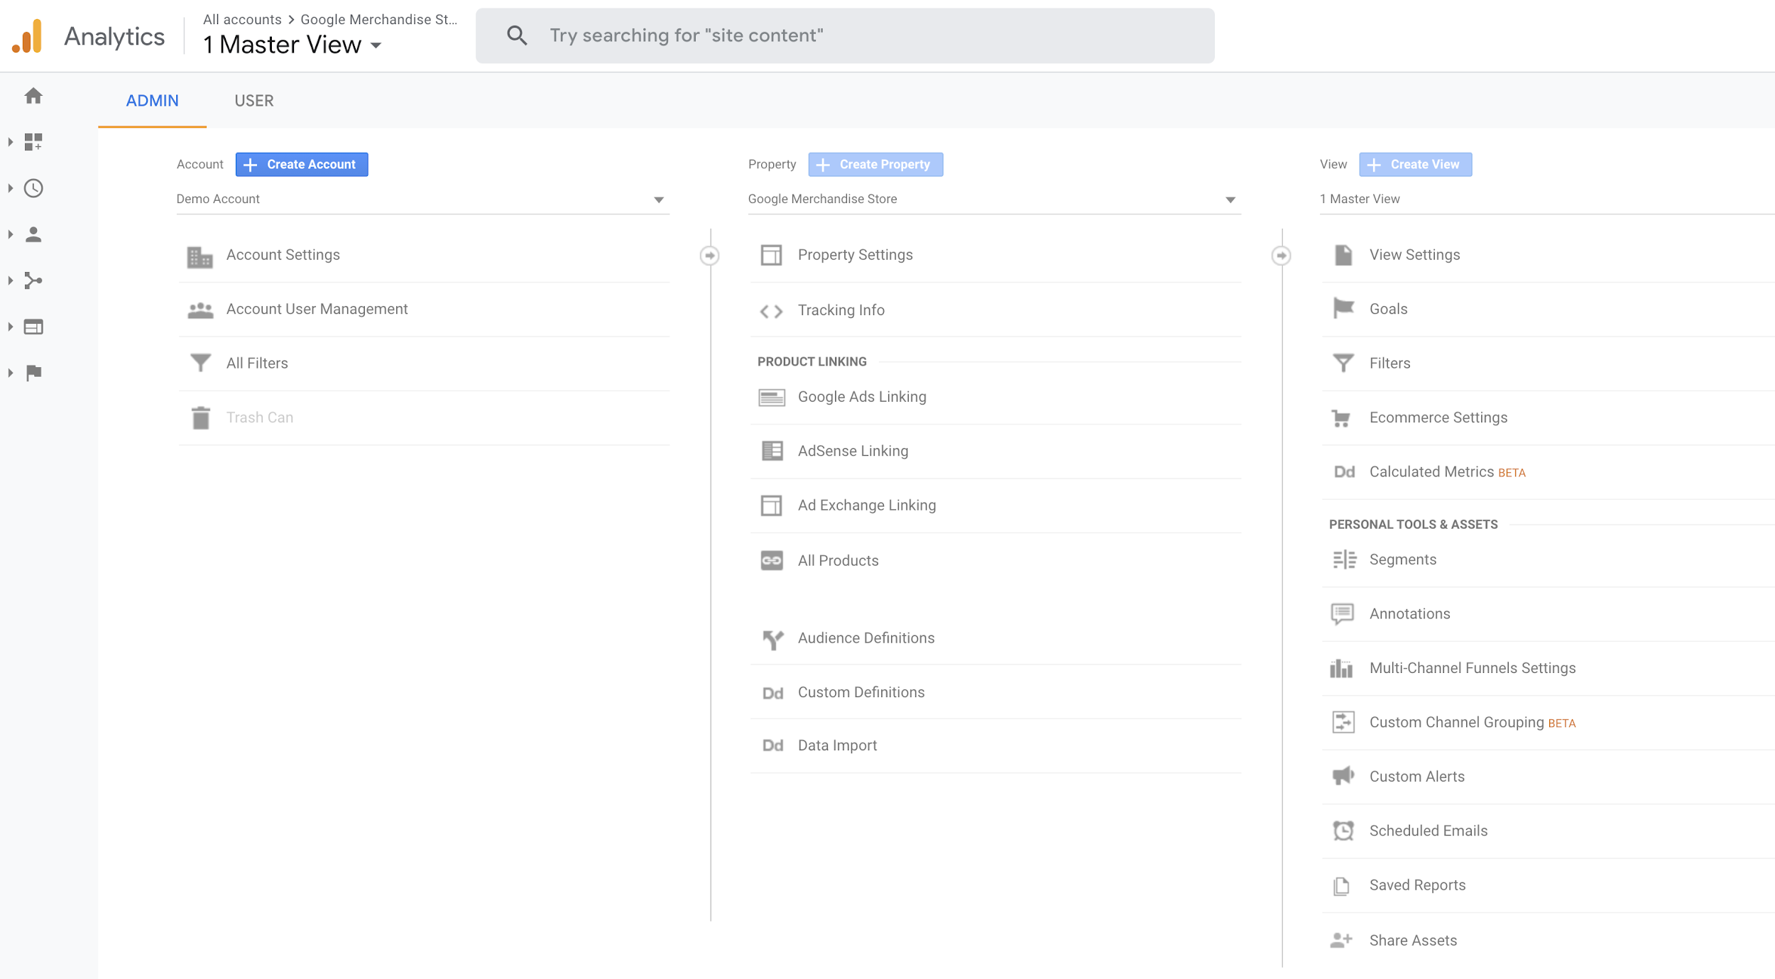
Adding Goals
Notes:
Purpose: Navigate to the goals section.
TALKING POINTS:
You won’t be able to follow along on the demo account, but we can walk through how to set up a goal on the platform.

Slide 73
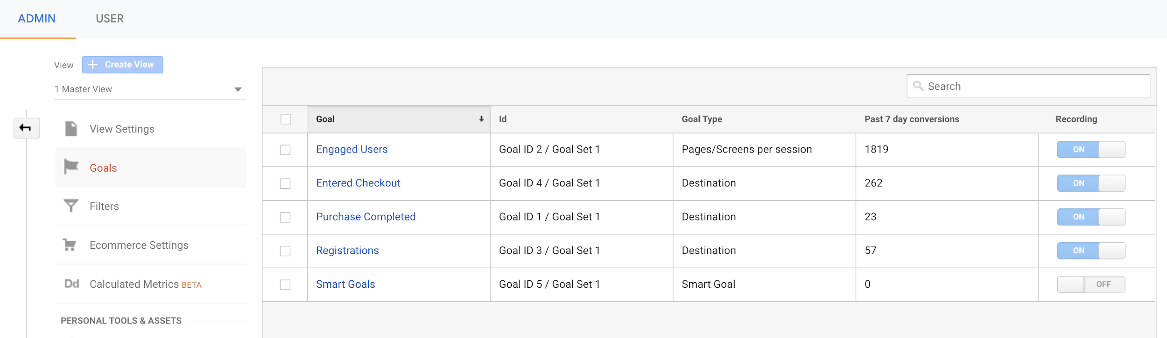
Admin Tab: Adding Goals
Notes:
Purpose: Show the created goals.

Slide 74
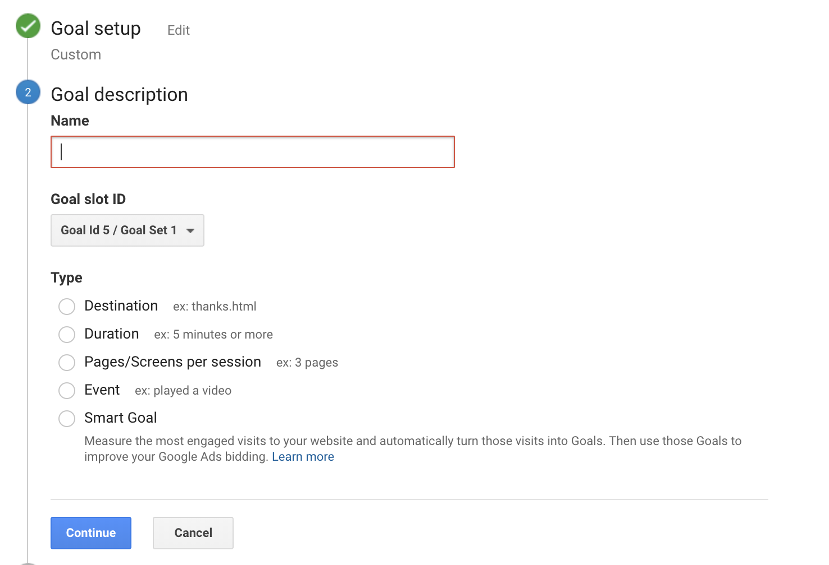
Types of Goals: Choices
Select “Custom”
Notes:
Purpose: Go over how to set up goals in the admin tab.
TALKING POINTS:
As you can see on this slide, we can set one of several goal options. We covered four, but there are five types of goals you can create.
“Smart Goal” is Google’s way to automate and make things easier for users, but it isn’t an effective way of utilizing goals.
You can see that the first step to creating a goal is to name it. Keep it simple and clear.

Slide 75
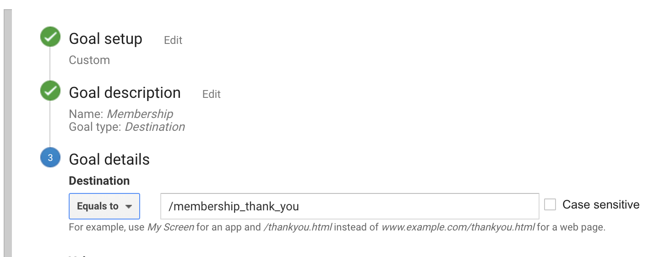
A Destination Goal
Notes:
Purpose: Go over how to set up goals in the admin tab.
TALKING POINTS:
Destination goals are goals that count when a user lands on a confirmation page.
Every time a user lands on a confirmation page after filling out a form, it counts as a conversion.

Slide 76
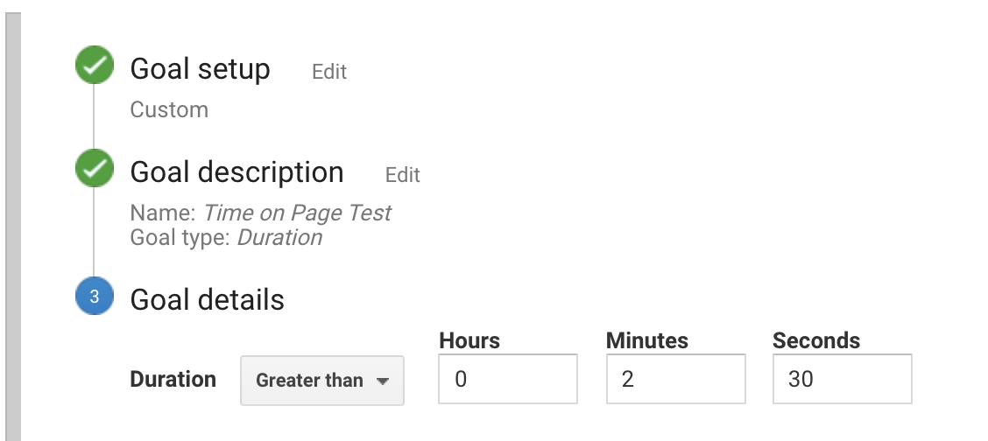
A Duration Goal
Notes:
Purpose: Go over how to set up goals in the admin tab.
TALKING POINTS:
Duration goals measure how many people spent a specified amount of time on your website.
Good for think tanks and other content-heavy sites (could also be that the user opened the site and never closed the tab but wasn’t really looking at the site).

Slide 77
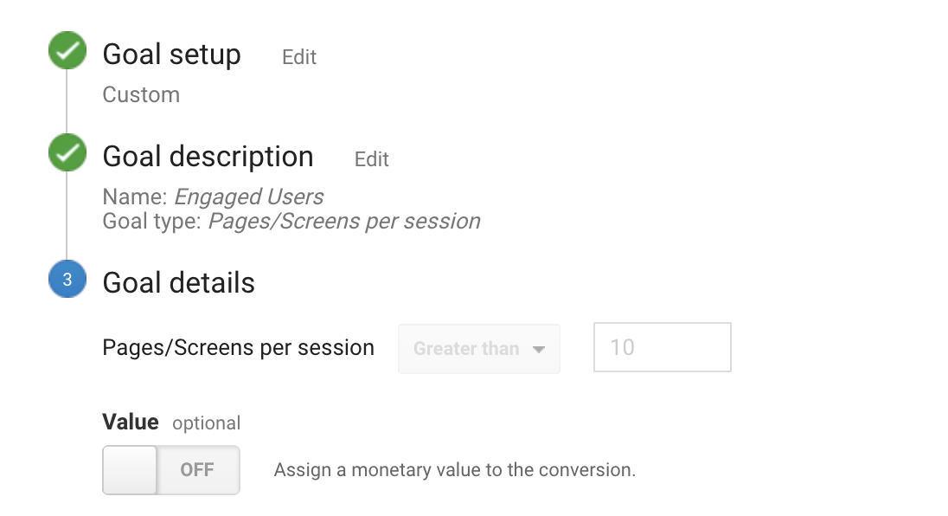
Pages/Screens per Session Goal
Notes:
Purpose: Go over how to set up goals in the admin tab.
TALKING POINTS:
Pages/Screens per session goal tracks how many pages users view.
Best for merchants with products on pages. (Note: Viewing multiple pages could also mean people can’t find what they’re looking for.)

Slide 78
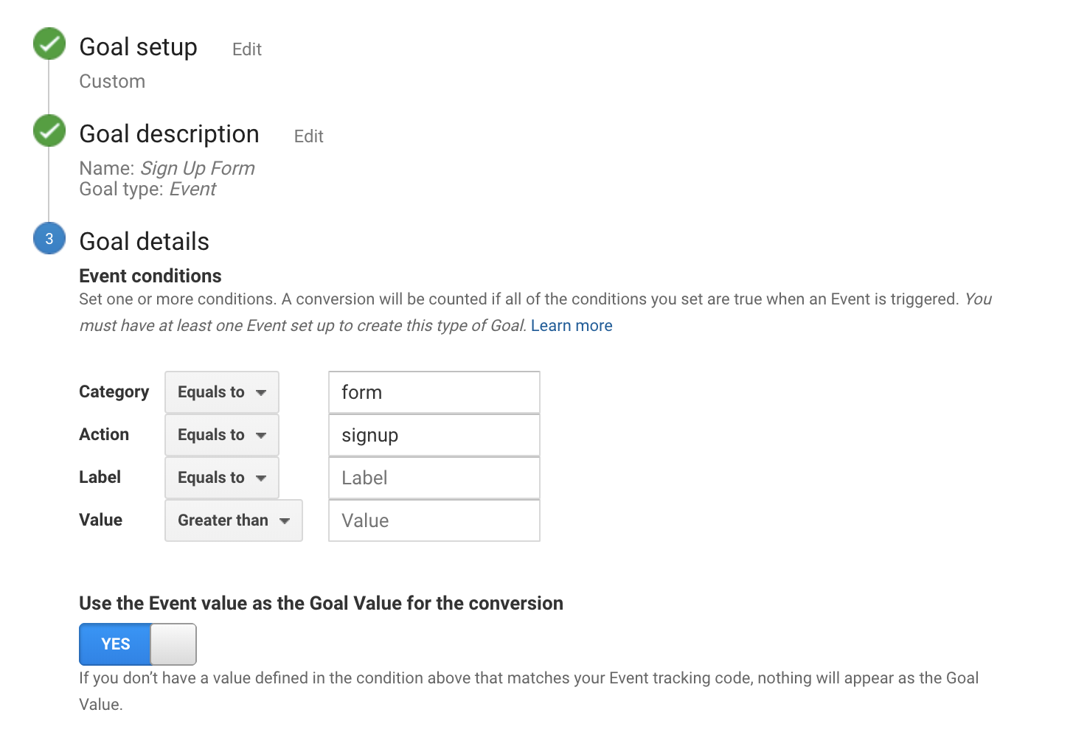
An Event Goal
Notes:
Purpose: Go over how to set up goals in the admin tab.
TALKING POINTS:
Event goals track actions: clicking a button, downloading a white paper, watching a video.
An event goal can be used in place of a destination goal. It involves inserting code behind the submit button, so it’s more complicated to configure.
This is different from events in behavior reports.

Slide 79
What’s Your Goal?
5 Minutes
Think about your current company and select the goal type that would be most impactful. Then, answer the following:
Why did you choose that goal?
What might you name that goal?
What are the details of the goal?
Be prepared to share out.
Notes:
Purpose: Give students a chance to apply goal setting to their company.
TEACHING TIPS:
If students struggle with this activity, you can walk them through a scenario for your company or a familiar brand.
Be sure to run a debrief so students can hear one another’s goals.

Slide 80
Practice, Practice, Practice
Getting Acquainted With Google Analytics
Asking Questions & Finding Insights
Setting Goals
Practice, Practice, Practice
Notes:
Duration: 60 Minutes

Slide 81
Practice, Practice, Practice
Activity + Debrief Guide
For each scenario provided, students will:
Come up with the questions that may answer or solve the scenario.
Find the answers to the questions in Google Analytics.
Pro tip: Find the answers while students are working. Convert to partner activities if you think your class would prefer that.
Be sure to debrief each activity:
What questions did they come up with?
What data did they find in Google Analytics?
How did they find it? (Emphasize there’s often more than one way to find it.)
If needed, share your screen and walk through how you found the answer. Students will want to know your thought process because you’re the expert.

Slide 82

Business Analysis
5 Minutes
Customize It!
Claire needs to be convinced that she should spend money and resources on optimizing her site for mobile.
Write down two questions we could ask Google Analytics to discover data that may convince Claire.
Be prepared to share out.
Claire
Business Owner
Notes:
Purpose: Connect a business scenario to questions students can ask Google Analytics.
TALKING POINTS:
Determine what questions we can ask Google Analytics to persuade Claire to invest (or not) in making her site more mobile-friendly.
TEACHING TIPS:
Lead a debrief so students can hear the questions others came up with.
FOR REMOTE CLASSROOMS:
Take a screenshot of this slide and post it on Slack.
If you decide to make this a partner activity, create breakout rooms for partners.
Lead a debrief by encouraging students to come off mute and share their answers.
Customize it!
Change the scenario to uncover different insights.

Slide 83
Business Analysis
10 Minutes
Customize It!
Find the answers to the questions:
What percentage of sessions and revenue are coming from mobile devices?
Have sessions and revenue from mobile increased since last month? If so, by what percentage?
If you were Claire, would you invest in mobile optimization?
Claire
Business Owner
Notes:
Purpose: Ask students to find answers to the questions provided.
TALKING POINTS:
Find the answers to the questions that may or may not convince Claire.
TEACHING TIPS:
Lead a debrief so students can hear the answers.
After hearing from a few students, ask the class if they think it’s worth optimizing the site for mobile users.
Customize it!
Change the questions to uncover different insights.

Slide 84

Marketing Analysis
10 Minutes
Customize It!
Mark wants to better understand the main source or medium that contributes to conversions on his site so he can spend time and money on the right channel.
Write down two questions we could ask Google Analytics to help Mark out.
Be prepared to share out.
Mark
Marketer
Notes:
Purpose: Connect a business scenario to questions students can ask Google Analytics.
TALKING POINTS:
Determine what questions we can ask Google Analytics to help Mark.
TEACHING TIPS:
Lead a debrief so students can hear the questions others came up with.
FOR REMOTE CLASSROOMS:
Take a screenshot of this slide and post it on Slack.
If you decide to make this a partner activity, create breakout rooms for partners.
Lead a debrief by encouraging students to come off mute and share their answers.
Customize it!
Change the scenario to uncover different insights.

Slide 85
Marketing Analysis
10 Minutes
Customize It!
Find the answers to the questions:
Which two sources or media are driving the most conversions? How do you know?
Which two sources or media are the least effective in driving conversions? How do you know?
Mark
Marketer
Notes:
Purpose: Ask students to find answers to the questions provided.
TALKING POINTS:
Find the answers to the questions to help Mark.
TEACHING TIPS:
Lead a debrief so students can hear the answers.
Customize it!
Change the questions to uncover different insights.

Slide 86

Website Analysis
10 Minutes
Customize It!
Goli has been tasked with reducing page load times but doesn’t know what to do first.
Write down two questions we could ask Google Analytics to help direct Goli’s optimization.
Be prepared to share out.
Goli
Web Developer
Notes:
Purpose: Connect a business scenario to questions students can ask Google Analytics.
TALKING POINTS:
Determine what questions we can ask Google Analytics to help Goli.
TEACHING TIPS:
Lead a debrief so students can hear the questions others came up with.
For remote classrooms:
Take a screenshot of this slide and post it on Slack.
If you decide to make this a partner activity, create breakout rooms for partners.
Lead a debrief by encouraging students to come off mute and share their answers.
Customize it!
Change the scenario to uncover different insights.

Slide 87
Website Analysis
10 Minutes
Customize It!
Find the answers to the questions:
Is there a difference in load time between mobile and desktop? If so, what might Goli’s next step be?
Goli
Web Developer
Notes:
Purpose: Ask students to find answers to the questions provided.
TALKING POINTS:
Find the answers to the questions to help Goli.
TEACHING TIPS:
Lead a debrief so students can hear the answers.
Customize it!
Change the questions to uncover different insights.

Slide 88
Bring It Home
Notes:
Duration: 30 Minutes

Slide 89
Reflect and Connect to Your Work
10 Minutes
Customize It!
When you return to work:
What data (report, dimensions, metrics) do you plan to look into regularly (every day, week, month) — and why?
What goals might you want to set up in Google Analytics — and why?
What would you include in a Google Analytics report for a boss or client — and why?
Notes:
Purpose: Give students the opportunity to reflect on what they’ve learned, framed as next steps for their work.
FOR REMOTE CLASSROOMS:
Ask students to share their answers on Slack, then read out a few responses.
Alternatively, ask a few students to come off mute and share their reflections.
Customize it!
Replace these with other thought-provoking questions that encourage students to apply what they’ve learned today to their work.

Slide 90

We Want Your Feedback!
A survey will be sent to you within 24 hours. Please keep an eye out for it and let us know what you liked about this class and what we can improve.
Thank you!
‹#› | © 2020 General Assembly

Slide 91
Questions?

Slide 92


Take Another Workshop
With [Name]!
Sign up at ga.co/[YourName]
Notes:
Instructions for use:
Replace all bracketed “[ ]” text with your name (in the yellow highlighted text) and in the URL in the red box (i.e. ga.co/YourName)
Reach out to your GA point of contact to have a ga.co short link created for you.
Right-click on circle labeled “Your photo” and select ‘Replace image’ > Upload from computer. Select your desired photo from your computer and click ‘Open’.

Slide 93

Workshops @ GA
Check out our marketing workshops in:
Digital Marketing
Google Analytics
Social Media
SEO
Content Marketing
Facebook and Instagram
Or explore all of our upcoming workshops: ga.co/workshops
‹#› | © 2020 General Assembly

Slide 94
Take Your Next Step with GA
 | Digital Marketing | Digital Marketing Immersive
Format | Part-time/evenings | Full-time/Monday–Friday
Next Course | <DATES> | <DATES>
Outcome | Learn to plan and execute a marketing campaign, acquire and engage users, and quantify a strategy’s success, ultimately developing a project to showcase your work. | Your best course for career transformation. This full-time digital marketing bootcamp features expert instruction, one-on-one career coaching, and connections to top employers to get you hired
Tuition | $3,950* | $<PRICE>*
*Financing options available.
‹#› | © 2020 General Assembly

Slide 95
Take Your Next Step with GA
 | Digital Marketing
Format | Part-time/evenings
Next Course | <DATES>
Outcome | Learn to plan and execute a marketing campaign, acquire and engage users, and quantify a strategy’s success, ultimately developing a project to showcase your work.
Tuition | $3,950*
*Financing options available.
‹#› | © 2020 General Assembly

Slide 96

Fund Your Future
We offer a range of student financing and payment options to make your path to education easy, including:
Installment plans
Loans
Scholarships
Income Share Agreements
…and more!
To explore all of our financing options, visit ga.co/financing.
‹#› | © 2020 General Assembly

Slide 97



Let’s Keep In Touch!
Curious about our courses? Speak to our admissions team and they’ll help you find the right path!
Admissions: ga.co/FindYourCourse
Want to experience GA beyond the classroom?
Events: ga.co/events
Follow us!
@generalassembly
@GA
@generalassembly
‹#› | © 2020 General Assembly

